Slide 1
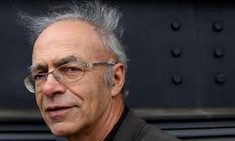
How to Live an Ethical Life
http://www.youtube.com/watch?v=G2HiIF8zBBY

Slide 2
Contemporary Moral Problems
M-F12:00-1:00SAV 264
Instructor: Benjamin Hole
Email: bvhole@uw.edu
Office Hours: everyday after class

Slide 3
Agenda
Clicker Quiz
Transition from Singer to Hardin
Demandingness Objection to Utilitarianism (both Hardin and Singer)
Hardin, introduction and as an objection to Singer

Slide 4
According to Singer, the fact that many other people are in a position to donate to famine relief:
makes both a psychological difference and a difference to our moral obligations.
makes a psychological difference, but no difference to our moral obligations.
makes no psychological difference, but makes a difference to our moral obligations.
makes neither a psychological difference nor a difference to our moral obligations.
None of the above

Slide 5
In the reading, Singer states:
“one could accept the argument without drawing the conclusion that it absolves one from any obligation to do anything to prevent famine. The conclusion that should be drawn is that the best means of preventing famine, in the long run, is population control”
“This conclusion is one which we may be reluctant to face. I cannot see, though, why it should be regarded as a criticism of the position for which I have argued, rather than a criticism of our ordinary standards of behavior”
“The traditional distinction between duty and charity cannot be drawn, or at least, not in the place where we normally draw it … People do not feel in any way ashamed or guilty about spending money on new clothes or a new car instead of giving it to famine relief … This way of looking at the matter cannot be justified … We would not be sacrificing anything significant if we were to continue to wear our old clothes, and give money to famine relief”
A & B
B & C
All of the above

Slide 6
One of the main factors that Hardin links to world hunger and poverty is:
population and reproduction rates
exploitation of other people
people having too many privileges
all of the above
none of the above

Slide 7
The Demandingness Objection
Demandingness & Distribution
Kinds of Demandingness
Psychological
Substantive

Slide 8
Singer’s Argument
If it is in our power to prevent something bad from happening, without thereby sacrificing anything of comparable moral importance, we ought to do it.
Suffering and death from lack of food, shelter, and medical care are bad … *
Therefore, members of affluent societies have a straightforward duty to give money to prevent starvation.
* things which members of affluent societies have the power to prevent without thereby …

Slide 9
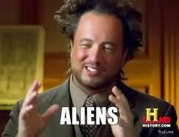
A kind of distribution objection ….
“Suppose that at some time in the future, humankind has solved all of its problems and entered a period of peace and economic prosperity for all. In the meantime, people have been engaged in space exploration and have recently discovered a new planet in which there are untold billions of people (perhaps human, perhaps alien of some sort …), all near starvation. To avoid mass starvation and death on this planet will require all people on earth to reduce their standard of living to the minimum required for survival for many generations. Are those living on earth morally required to do this …?” (BonJour/Baker, 352)

Slide 10
In this thought experiment, all people on earth are morally required to reduce their standard of living to the minimum required for survival.
Strongly Agree
Agree
Somewhat Agree
Neutral
Somewhat Disagree
Disagree
Strongly Disagree

Slide 11
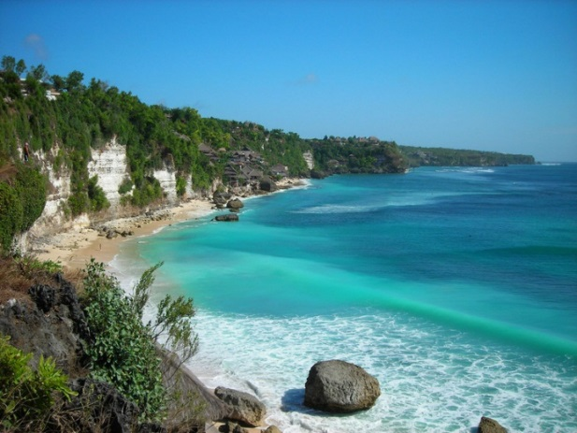
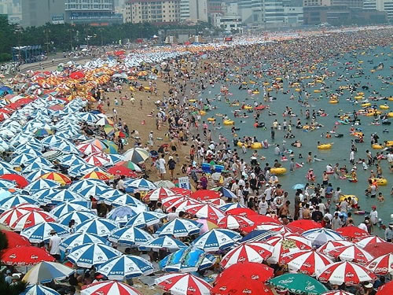
The Repugnant Conclusion
“For any possible population of … people, all with a very high quality of life, there must be some much larger imaginable population whose existence, if other things are equal, would be better even though its members have lives that are barely worth living” (Parfit 1984).

Slide 12

The Demandingness Objection
One desideratum of an ethical theory is practical guidance.
For a theory to be practically guiding, it must not make unlivable demands from its practitioners.
Utilitarianism makes unlivable demands.
Therefore, utilitarianism fails the practical guidance desideratum of ethical theory.

Slide 13
The Demandingness Objection
Psychological
Substantive

Slide 14

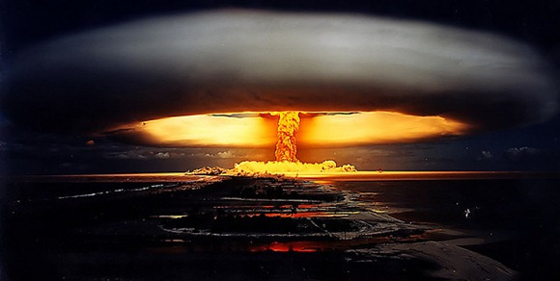
The Demandingness Objection
Psychological
“Orneriness objection”
Hard to calculate

Slide 15
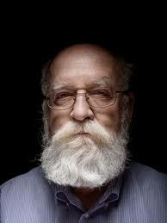
The Demandingness Objection
“we still have no idea whether [the Three Mile Island nuclear disaster] is to be counted among the good things that happened or the bad, all things considered” (Darwin's Dangerous Idea: Evolution and the Meanins of Life, 499)

Slide 16
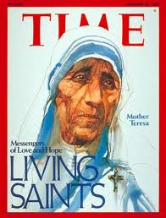
Psychological Demandingness (for motivation)
A good utilitarian must always be motivated, in action, to maximize the aggregate net benefit.

Slide 17
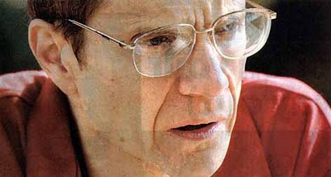
Is Utilitarianism Too Demanding?
Substantive Objection
Utilitarianism forbids such actions as going on vacation when the money would do more good when donated to charity.

Slide 18
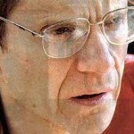
Substantive Demandingness
http://www.smbc-comics.com/?id=2305
Substantive
Zell Kravinsky … has given away one of his kidneys as well as most of his 45 million dollar real estate fortune.
http://www.stafforini.com/blog/the-gift/
http://www.nytimes.com/2006/12/17/magazine/17charity.t.html?pagewanted=4&ref=magazine&_r=0
http://www.youtube.com/watch?v=RvUcbcUMtXw

Slide 19
Demandingness?
Objection
Singer’s Response
“It follows from some forms of utilitarian theory that we all ought, morally, to be working full time to increase the balance of happiness over misery”
The approach is far less demanding, but still asks us to do a lot.
“This conclusion is one which we may be reluctant to face. I cannot see, though, why it should be regarded as a criticism of the position for which I have argued, rather than a criticism of our ordinary standards of behavior”

Slide 20
Utilitarianism is overly demanding
Strongly Agree
Agree
Somewhat Agree
Neutral
Somewhat Disagree
Disagree
Strongly Disagree

Slide 21
Utilitarianism is the most demanding ethical theory
Strongly Agree
Agree
Somewhat Agree
Neutral
Somewhat Disagree
Disagree
Strongly Disagree

Slide 22
Garrett Hardin, “Lifeboat Ethics”
Introduction and as an Objection to Singer

Slide 23
Singer’s Argument
If it is in our power to prevent something bad from happening, without thereby sacrificing anything of comparable moral importance, we ought to do it.
Suffering and death from lack of food, shelter, and medical care are bad … *
Therefore, members of affluent societies have a straightforward duty to give money to prevent starvation.
* things which members of affluent societies have the power to prevent without thereby …

Slide 24
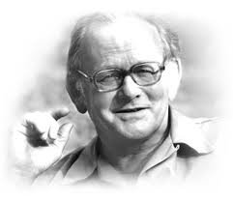
Garrett Hardin on Overpopulation
https://www.youtube.com/watch?v=WIObJ7VN_Q0

Slide 25
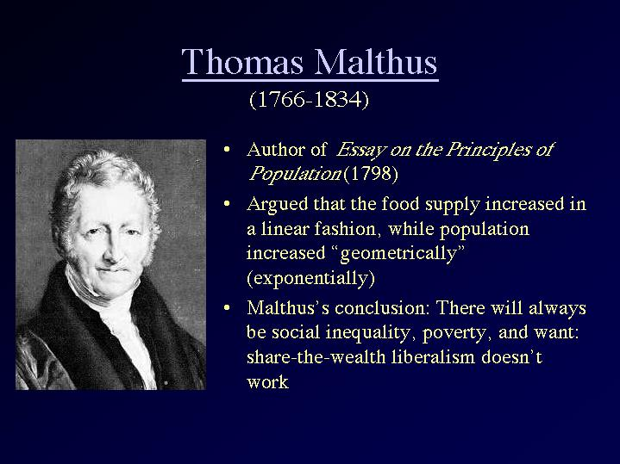
Population and Hunger

Slide 26


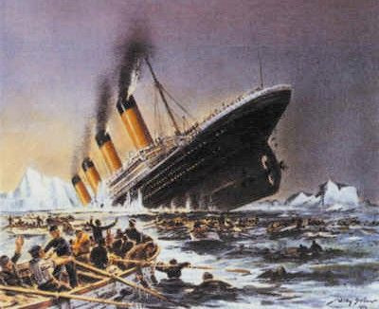
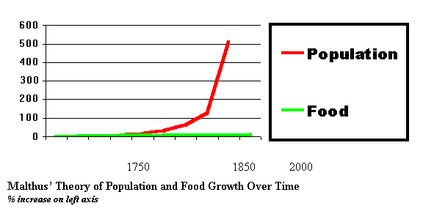
The ‘Population’ Objection
Objection
“until there is effective population control, relieving famine merely postpones starvation”

Slide 27
Collective Action Problems
The Prisoner’s Dilemma & Immoralist’s Challenge
Tragedy of the Commons
The International Tragedy of the Commons
The Intergenerational Tragedy of the Commons

Slide 28
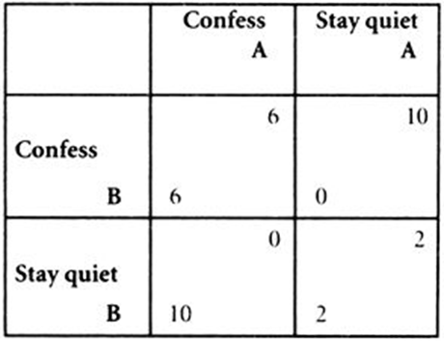
The Prisoner’s Dilemma
Individually rational to not cooperate
Collectively rational to cooperate
Standard Solutions
Appeal to fairness
Appeal to broader self-interests
http://www.investopedia.com/video/play/prisoners-dilemma/

Slide 29
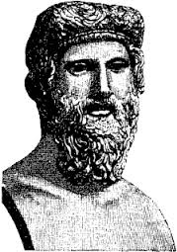
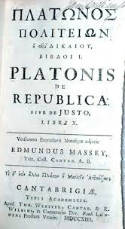
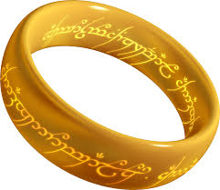
The Prisoner’s Dilemma
Individually rational to not cooperate
Collectively rational to cooperate
Standard Solutions
Appeal to fairness
Appeal to broader self-interests

Slide 30
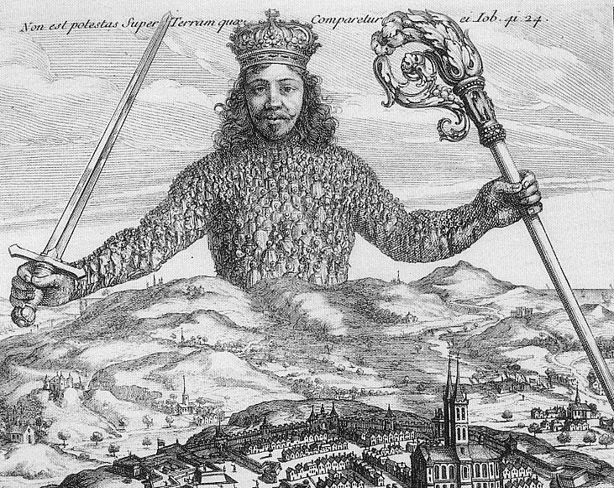
The State of Nature and Social Contract
We are rationally required to leave the state of nature and submit to a coercive authority in order to adjudicate between conflicts of individual interests.

Slide 31
The State of Nature and Social Contract
Rationality
Autonomous or Heteronomous?

Slide 32
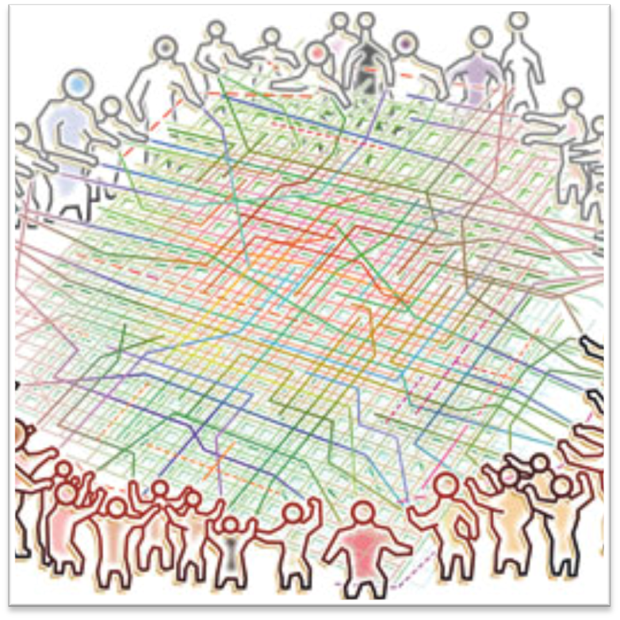
The Tragedy of the Commons
“The tragedy of the commons is a … situation in which multiple individuals, acting independently and rationally consulting their own self-interest, will ultimately deplete a shared limited resource even when it is clear that it is not in anyone's long-term interest for this to happen.”
http://www.princeton.edu/~achaney/tmve/wiki100k/docs/Tragedy_of_the_commons.html
Notes:
32

Slide 33

The International Tragedy of the Commons
State Sovereignty
Treaty of Westphalia (1648)
States as individual actors in the International state of nature.
Given state sovereignty, there is no power greater than the state.
Notes:
33

Slide 34
The International Tragedy of the Commons
Is the right solution (1) an appeal to fairness or (2) an appeal to broader self-interests?
Notes:
34

Slide 35
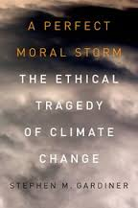
The Intergenerational Tragedy of the Commons
Each generation is an actor, across time, in an intergenerational collective action problem.
Notes:
35

Slide 36
The Repugnant Conclusion
“For any possible population of … people, all with a very high quality of life, there must be some much larger imaginable population whose existence, if other things are equal, would be better even though its members have lives that are barely worth living” (Parfit 1984).

Slide 37
Is the right solution to a collective action problem is (A) an appeal to fairness or (B) an appeal to broader self-interests?
an appeal to fairness
an appeal to broader self-interests
Neither

